Slide 1
Policy Instruments
Introduction
Direct regulation
Voluntary agreements
Coasian bargaining

Slide 2
Next week’s seminar
Option 1: Online game about today’s topic
Option 2: Problem set on demand curves and changes in consumer surplus

Slide 3
0 Introduction
1 Social choice
2 Externalities and public goods
3 Decision analysis
4 Valuation: Aims and purpose
5 Valuation: Revealed preferences
6 Valuation: Stated preferences
7 Direct regulation
8 Market-based instruments
9 Complications with instruments
SPRING BREAK
10 Growth and justice
11 Green accounting

Slide 4
0 Introduction
1 Social choice
2 Externalities and public goods
3 Decision analysis
4 Valuation: Aims and purpose
5 Valuation: Revealed preferences
6 Valuation: Stated preferences
7 Direct regulation
8 Market-based instruments
SPRING BREAK
9 Complications with instruments Growth and justice
10 Growth and the environment Green accounting
11 Green accounting Exam preparation

Slide 5
Policy Instruments
Introduction
Justification for regulation
Policy instruments
Pollution types
Criteria to evaluate policy instruments
Direct regulation
Voluntary agreements
Coasian bargaining

Slide 6
Why regulate?
Public goods (Smith, 1776)
Market power (Cournot, 1838)
Natural monopoly (Mill, 1848)
Spillovers (Marshall, 1890)
Externalities (Pigou, 1920)
Asymmetric information (Akerlof, 1970)
Multiple market imperfections
Rent seeking

Slide 7
Direct regulation / prescriptive instruments
Inputs, technology
Output (product, pollutant)
Location (source, individual)
Timing
Prohibition
Market-based / incentive-conform instruments
Taxes (inputs, outputs)
Subsidies
Tradeable permits
Institutional
Bargaining
Legal redress
Property rights
Information, awareness, responsibility
Voluntary agreements

Slide 8
Types of pollution
Stock and flow pollutants
Nuclear waste, noise
Medium
Water, air, soil
Point and diffuse sources
Nuclear power, cars
Spatially concentrated and homogenous impact
Nature reserve, UV-B radiation
Local, regional, contintenal, global
Noise, air pollution, acidification, climate change
Matters for understanding and regulation

Slide 9
Criteria
Cost-effectiveness
Administrative costs
Information requirements
Environmental effectiveness
Enforceability
Long-run effects and dynamic efficiency
Flexibility and uncertainty
Equity

Slide 10
Policy Instruments
Introduction
Direct regulation
Voluntary agreements
Coasian bargaining

Slide 11
Direct regulation
Prescriptive instruments, command and control
It is the most common form of environmental regulation, reflecting a natural science and legal frame of mind, and highly successful in past management of point sources of toxics
Essentially, command and control prescribes aspects of the production process, be it inputs, production or outputs
Requires substantial knowledge on the part of the regulator
Requires homogenous producers

Slide 12
Types of Direct Regulation
Inputs, e.g., fuel efficiency
Technology, e.g., catalytic convertors
Outputs
Products, e.g., carcinogenic toys
Waste, e.g., sulphur emissions
Timing, e.g., air traffic
Location, e.g., nature reserves
Prohibition, e.g., CFCs

Slide 13
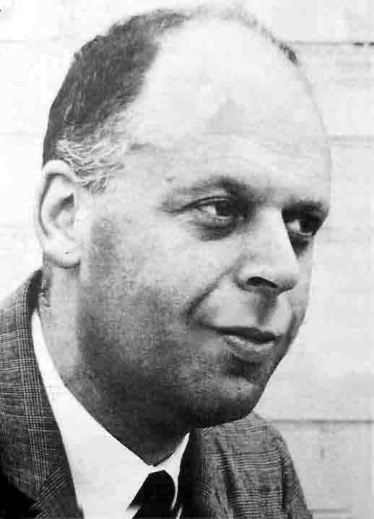
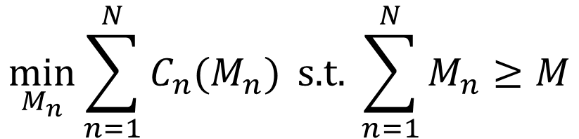

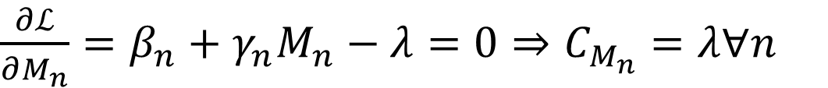
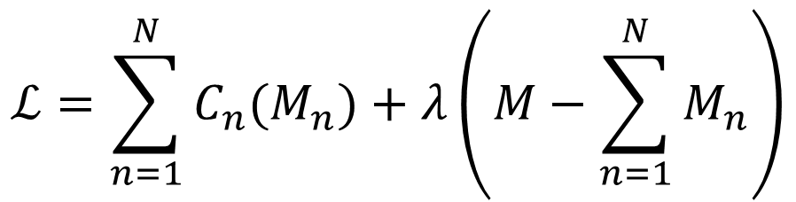
Cost-effectiveness
$$C_{n}=β_{n}M_{n}+0.5γ_{n}M_{n}^{2}$$
$$\min_{M_{n}}{\sum_{n=1}^{N}{C_{n}(M_{n})}} \text{s}\text{.}\text{t}\text{. }\sum_{n=1}^{N}{M_{n}}≥M$$
Marginal costs are equal for all polluters.
$$ℒ=\sum_{n=1}^{N}{C_{n}(M_{n})}+λ\left(M−\sum_{n=1}^{N}{M_{n}}\right)$$
$\frac{∂ℒ}{∂M_{n}}=β_{n}+γ_{n}M_{n}−λ=0⇒C_{M_{n}}=λ∀n$

Slide 14
Cost-effectiveness
$$C_{n}=β_{n}M_{n}+0.5γ_{n}M_{n}^{2}$$
$$\min_{M_{n}}{\sum_{n=1}^{N}{C_{n}(M_{n})}} \text{s}\text{.}\text{t}\text{. }\sum_{n=1}^{N}{M_{n}}≥M$$
Marginal costs are equal for all polluters.
Emission reduction targets are specific to each polluter.
$$ℒ=\sum_{n=1}^{N}{C_{n}(M_{n})}+λ\left(M−\sum_{n=1}^{N}{M_{n}}\right)$$
$\frac{∂ℒ}{∂M_{n}}=β_{n}+γ_{n}M_{n}−λ=0⇒C_{M_{n}}=λ,M_{n}=\frac{λ−β_{n}}{γ_{n}}∀n$

Slide 15

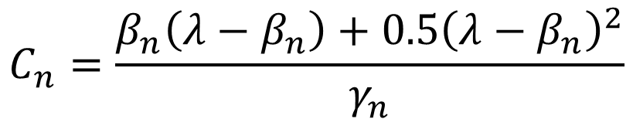
Distribution of costs
$\frac{∂ℒ}{∂M_{n}}=β_{n}+γ_{n}M_{n}−λ=0⇒M_{n}=\frac{λ−β_{n}}{γ_{n}}∀n$
$$C_{n}=β_{n}M_{n}+0.5γ_{n}M_{n}^{2}⇒$$
$$C_{n}=\frac{β_{n}\left(λ−β_{n}\right)+0.5{\left(λ−β_{n}\right)}^{2}}{γ_{n}}$$
 |  |  | equal reduction |  | equal marginal cost
 | β | γ | M | C | M | C
A | 1 | 1 | 1.00 | 1.50 | 1.82 | 3.47
B | 1 | 10 | 1.00 | 6.00 | 0.18 | 0.35
A+B |  |  | 2.00 | 7.50 | 2.00 | 3.82
Company A (B) will lobby for equal marginal costs (reduction)

Slide 16

Administrative costs
Firms fare differently under different regulations, and may lobby for the one that favours them
Bureaucrats may not be neutral either
Some regulations are easy and cheap to implement, others are hard and expensive
All else equal, a social planner prefers the former
However, complicated administration implies a larger bureau

Slide 17
UK Climate Change Levy
Power | 0.00847 | £/kWh | 0.285 | kgCO2/kWh | 2.41 | £/tCO2
Gas | 0.00339 | £/kWh | 0.028 | kgCO2/kWh | 0.10 | £/tCO2
Gas if CCA* | 0.00075 | £/kWh | 0.028 | kgCO2/kWh | 0.02 | £/tCO2
Gas if CPS** | 0.00331 | £/kWh | 0.028 | kgCO2/kWh | 0.09 | £/tCO2
CCA: Climate change agreement – lower carbon for companies
with a bespoke contract with the government to reduce emissions.
CPS: Carbon price support – applies to gas for heat and power. Note
that large installations also fall under the EU ETS.

Slide 18
Policy Instruments
Introduction
Direct regulation
Voluntary agreements
Coasian bargaining

Slide 19
Voluntary Agreements
Enviromental regulation requires a lot of knowledge, perhaps more so than at the disposal of the regulator
Increasingly, governments and industry negotiate over emission targets, the results of which are laid down in a voluntary agreement
This is a euphemism, as the government typically threatens to intervene if no voluntary agreement is used
Voluntary agreements make optimal use of the information within industry but have a problem with public acceptability

Slide 20
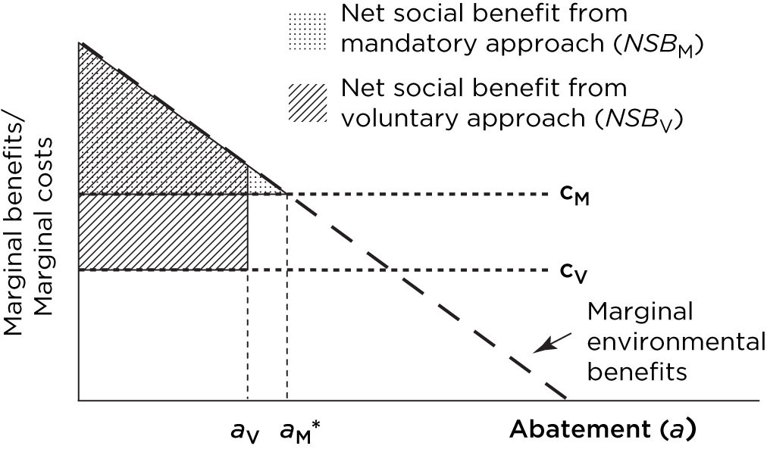

Voluntary Agreements
Abatement costs; voluntary, mandatory
$$C_{V}\left(a\right)=c_{V}a{, C}_{M}\left(a\right)=c_{M}a, c_{V}<c_{M}$$
Net social benefits
$${NSB}_{V}\left(a\right)={B\left(a\right)−c}_{V}a{, NSB}_{M}\left(a\right)=B\left(a\right)−c_{M}a$$

Slide 21
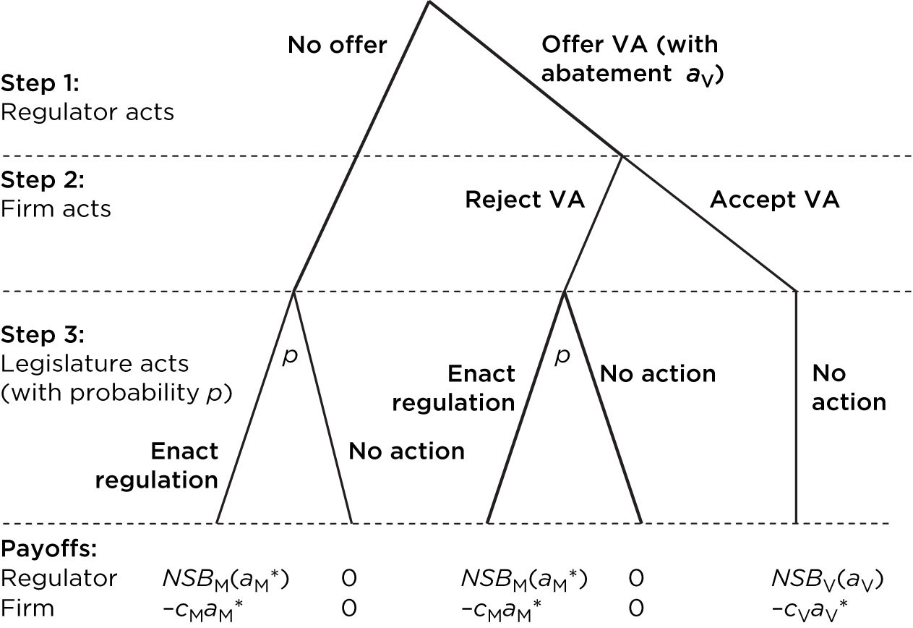
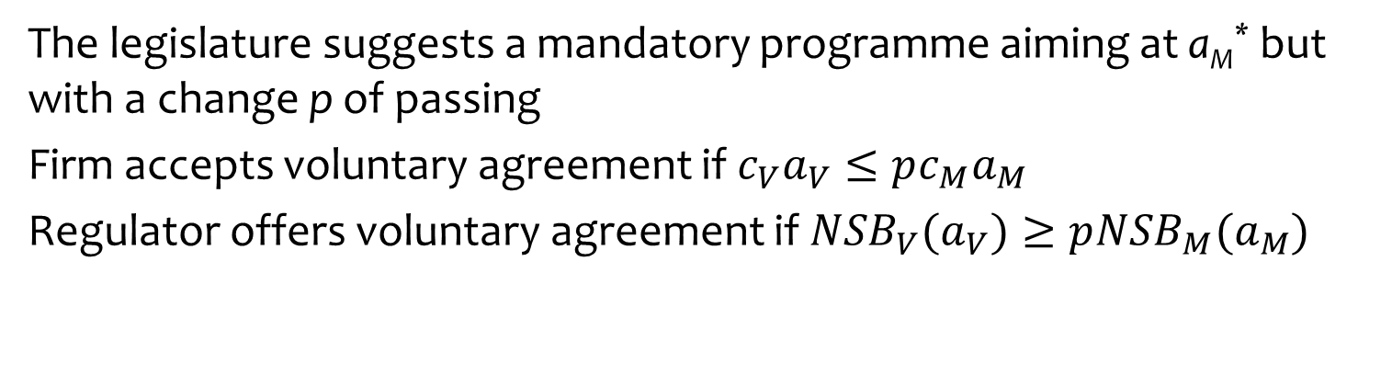
Voluntary agreement is better than mandatory regulation, but how can the legislator trust the polluters to stick with the agreement?
The legislature suggests a mandatory programme aiming at a_{M}* but with a change p of passing
Firm accepts voluntary agreement if $c_{V}a_{V}≤pc_{M}a_{M}$
Regulator offers voluntary agreement if ${NSB}_{V}(a_{V})≥p{NSB}_{M}(a_{M})$

Slide 22
Green Consumers & Workers
Companies may also reduce pollution because their consumers demand so
Green products are more expensive to make, but command a higher price
Employees and prospective employees may demand the same
Bosses and owners can be green too
Some of this is genuine, some greenwashing, some self-interest

Slide 23



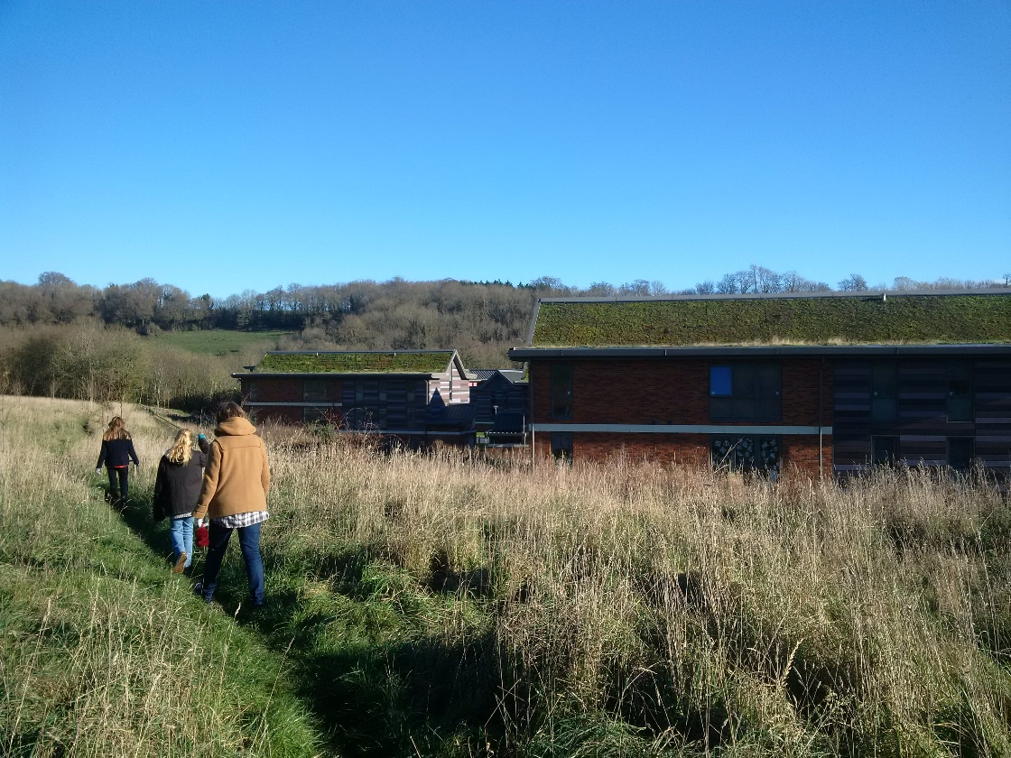


Slide 24
Policy Instruments
Introduction
Direct regulation
Voluntary agreements
Coasian bargaining

Slide 25
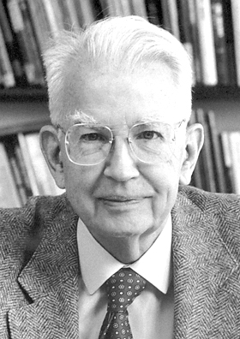
Property rights
Coase Theorem: The social optimum can be established through bargaining between polluter and pollutee (efficiency thesis), and the outcome is the same regardless of the initial allocation of rights (invariance thesis)
Efficiency thesis = first welfare theorem
Invariance thesis =/= second welfare theorem
If bargaining does not work, the court may step in or the government may establish property rights

Slide 29
Coase Theorem
If the market is completed by assigning property rights (efficiency thesis), it will find a Pareto optimum
The Pareto optimum does not depend on who gets the property (invariance thesis)
Key assumptions
No transaction costs
All relevant information revealed in bargain
Zero income elasticities
Zero loss aversion
So, does this work in reality?

Slide 30
Experiments
The Coase Theorem has been extensively tested in experiments
It has been generally confirmed
Many of the assumptions have been relaxed, and Coase still sort of works

Slide 31
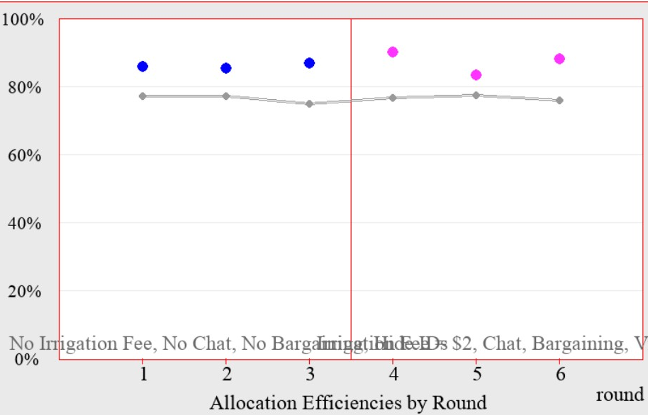
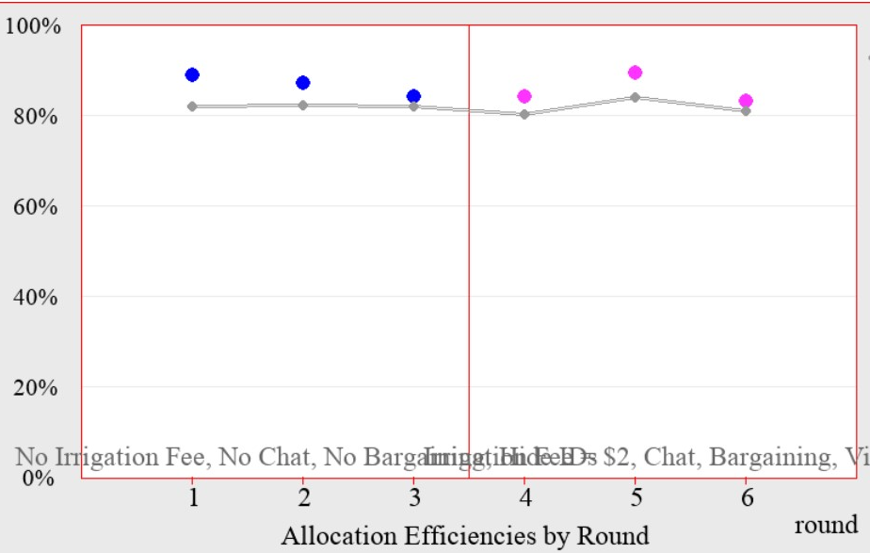
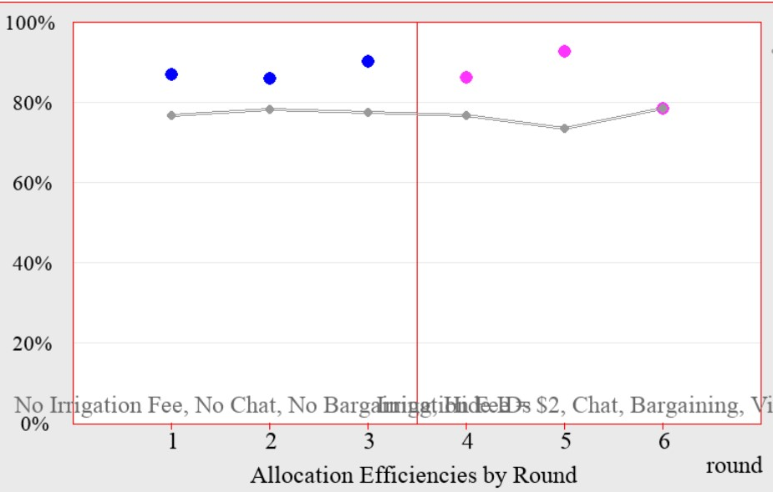


Slide 32
Water allocation
 | Player 1 | Player 2 | Player 3 | Player 4
Group 1 | 2.00 | 0.81
 | 1.33 | 1.24
Group 2 | 1.83 | 1.67 | 0.17
 | 1.75 | 1.50 | 0.25
Group 3 | 2.25 | 0.75
 | 1.58 | 1.33
Group 4 | 1.73 | 2.40 | 1.60 | 0.20
 | 1.07 | 1.80 | 1.73 | 1.27

Slide 33
Polluter pays
Mines de Potasse d’Alsace began dumping chlorides in the Rhine in 1931, after concerns about local groundwater contamination
This caused problems with drinking water in downstream Netherlands
Agreement in 1972 on cost-sharing for emission reduction: Netherlands (34%), France (30%), Germany (30%), Switzerland (6%)
Germany and Switzerland rather paid France than clean up their own emissions

Slide 34
Polluter pays
Revised agreement in 1991
Swiss contribution halved, as an offending plant had closed
Dutch contribution largely diverted to enhanced drinking water purification
Agreement now almost completely polluter pays
Note: No courts involved

Slide 35


Tort of nuisance
King John ruled against Jordan the Miller who had flooded Simon of Merston’s land
In Common Law, since 1201, the polluter pays
Since 1938 (Trail Smelter) same is true across borders
In the USA, chemical and power companies regularly buy up entire villages near industrial facilities
sometimes after an accident
sometimes after a near-miss, and
sometimes in anticipation of lawsuits on noise and contamination

Slide 36
Pollutee pays
Typically, the polluter pays. But not always.
Vittel (Nestlé) pays farmers near its springs to reduce the use of fertilizers well below the legal limits
New York City has bought 100,000 acres of land in the Catskill-Delaware watershed, which was cheaper than building a water treatment plant
Sweden and Finland pay for the reduction of water and air pollution in Poland, the Baltic states and, to some extent, Russia
Japan tried to do the same

Slide 37
Pollutee pays, coordination
Santa Maria, CA, imposed a tax on houses near a smelly feedlot and used the revenue to buy out the company
Nature Conservancy and Environmental Defense Fund raised funds to buy out fishing rights and equipment
Nature Conservancy used a reverse auction to get rice farmers to flood land to create wetlands for migratory birds during spring

Slide 38
Coase Theorem
If the market is completed by assigning property rights (efficiency thesis), it will find a Pareto optimum
The Pareto optimum does not depend on who gets the property (invariance thesis)
Stringent assumptions, but seems to work in practice
Coase bargaining can internalize externalities that are hard to reach by other policy instruments

